Slide 1






Foundations of
Quantum Information Science (QIS 101)
Dave Biersach
Brookhaven National Laboratory
dbiersach@bnl.gov
Session 24b
Quantum Algorithms

Slide 2
Session 24b – Goals
Appreciate how qubits enable superdense coding
Obtain an IBM Cloud Account (IBMid) and a Qiskit API Key
Understand the QiskitRunTimeService and the Qiskit Sampler & Estimator primitives
Create a Bell Pair on a real IBM Quantum Computer
Apply principles of the Fourier Transform to perform Quantum Phase Estimation (QPE) on a qubit
Implement a simple Variation Quantum Eigensolver (VQE) to find the minimum eigenvalue of a Hamiltonian Operator
Consider if superposition and entanglement enable a sub-exponential solution to the Boolean Satisfiability Problem

Slide 3
Super Dense Coding
Superdense coding is a quantum communication protocol that allows transmitting two classical bits using only a single qubit as the carrier. Consequently, superdense coding doubles the efficiency of classical information transmission compared to traditional methods where one qubit carries only one classical bit
Superdense coding can be combined with other quantum protocols, such as quantum key distribution (QKD), to improve security in communication channels. QKD enables the secure distribution of cryptographic keys based on the laws of quantum mechanics. By utilizing superdense coding, these keys can be transmitted more efficiently and securely, reducing the vulnerability to eavesdropping or interception
Superdense coding offers benefits such as increased information transmission efficiency, resource conservation, compatibility with quantum networks, enhanced security, and contributions to the progress of quantum information science. These advantages make superdense coding a valuable tool in the field of quantum communication and quantum computing

Slide 4
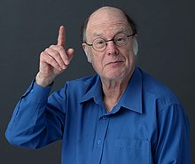
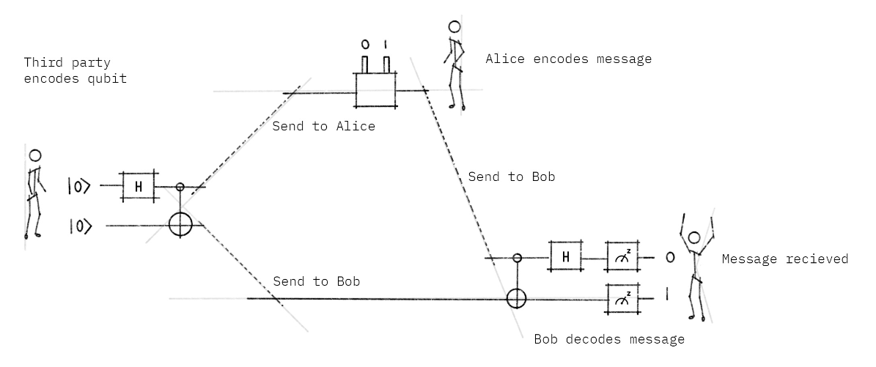
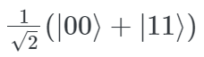
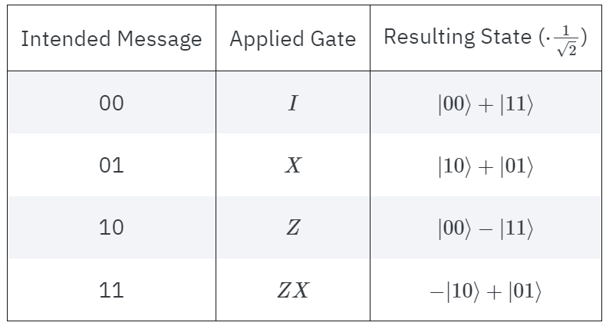
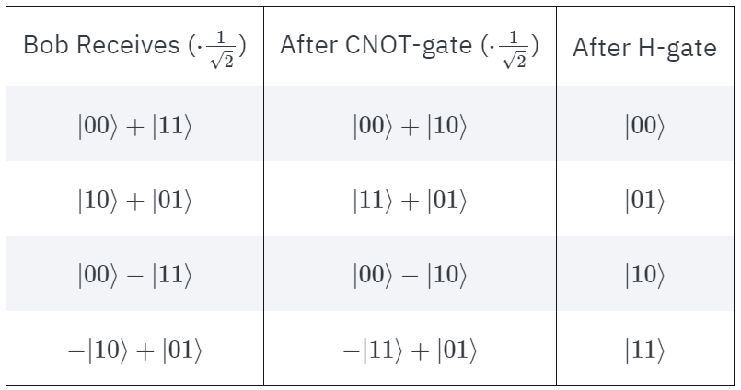
Superdense Coding
A trusted third party entangles two qubits
Qubit A
Charles Bennett
(1943 - )
Qubit B

Slide 5
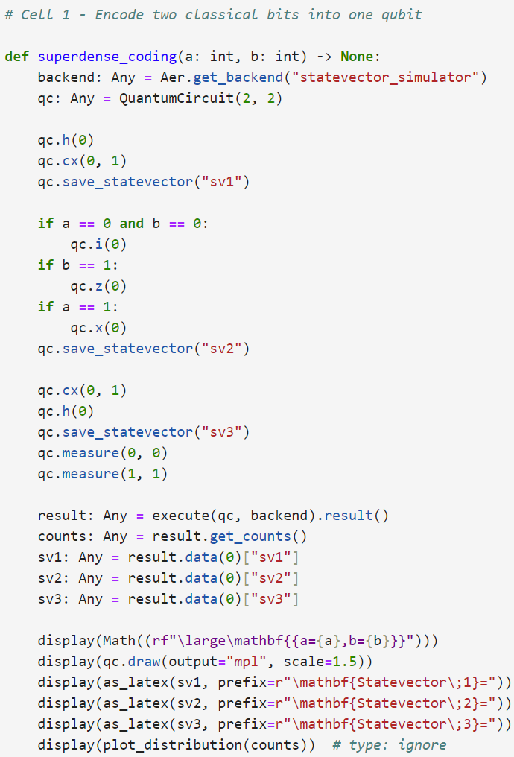
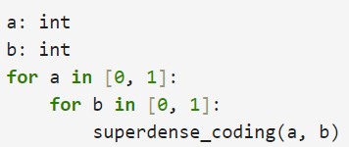
View Cell 1 superdense_coding.ipynb
①
②
③
ba
④
⑤
Z must be applied before X
⑥
⑦
⑩
⑧
⑨

Slide 6
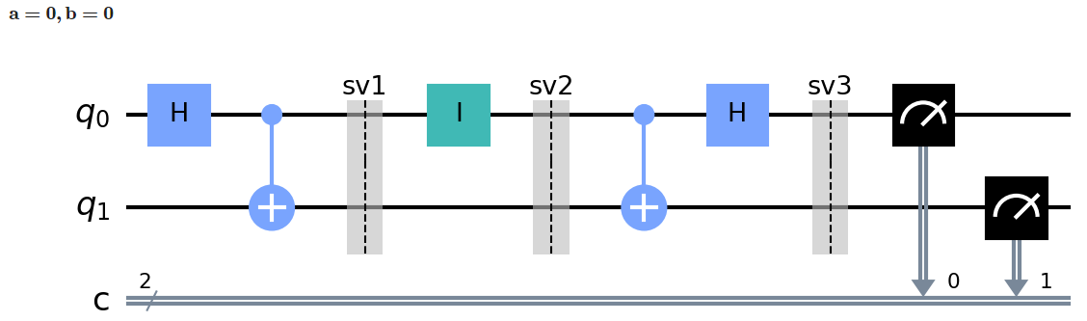
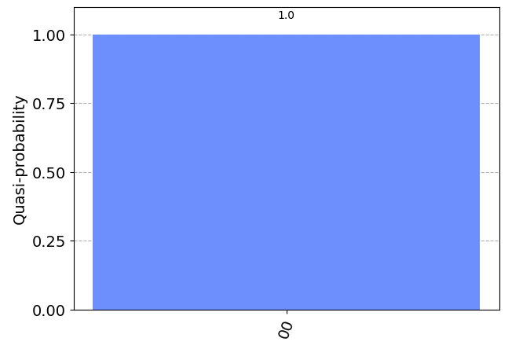
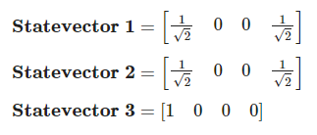
Run Cell 1 – superdense_coding.ipynb

Slide 7
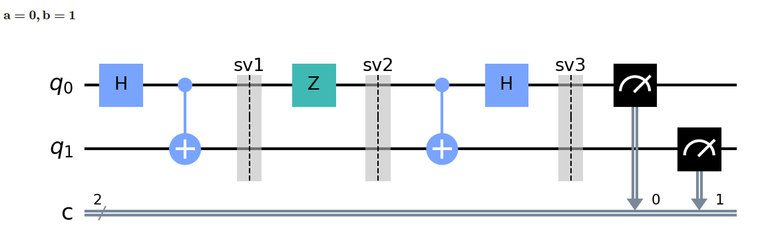
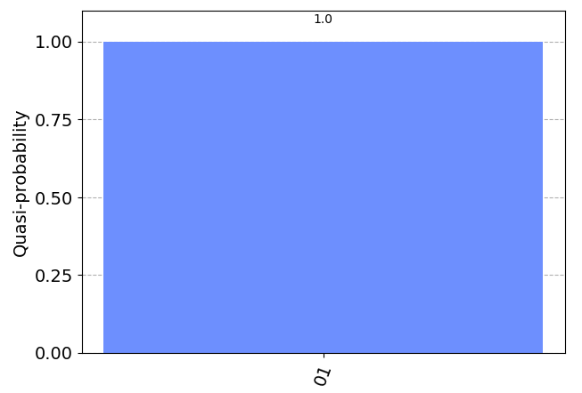
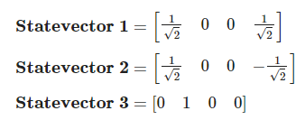
Check Cell 1 – superdense_coding.ipynb

Slide 8
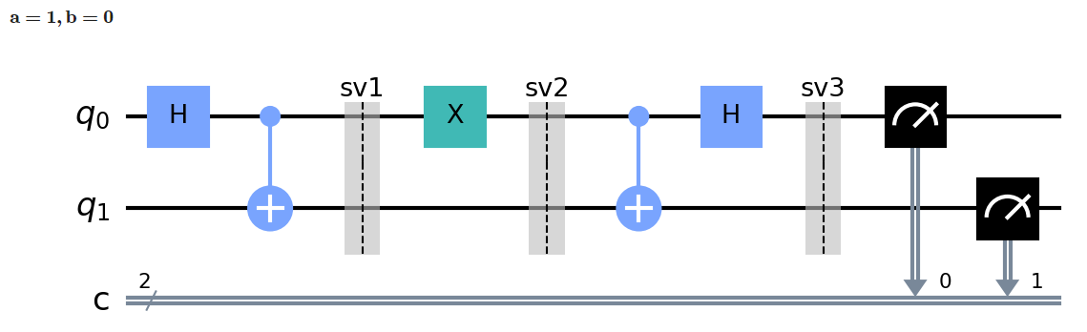
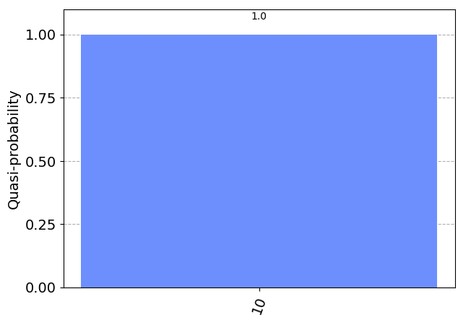
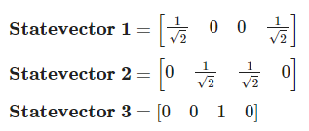
Check Cell 1 – superdense_coding.ipynb

Slide 9
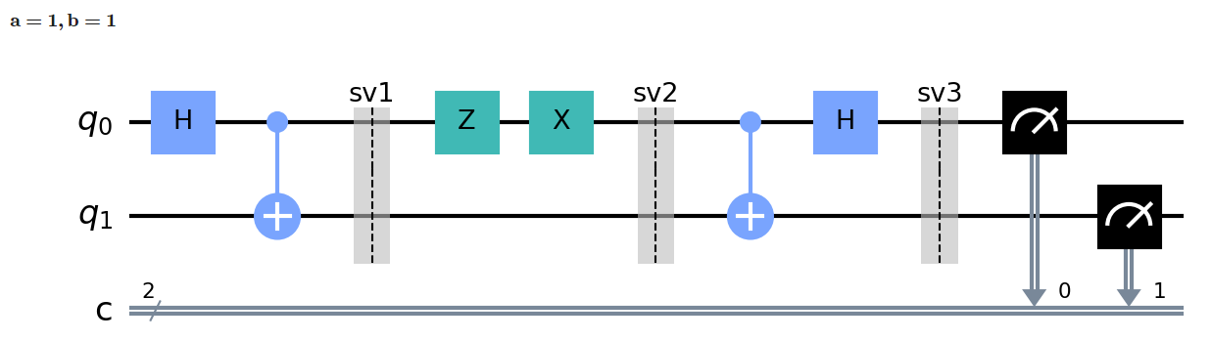
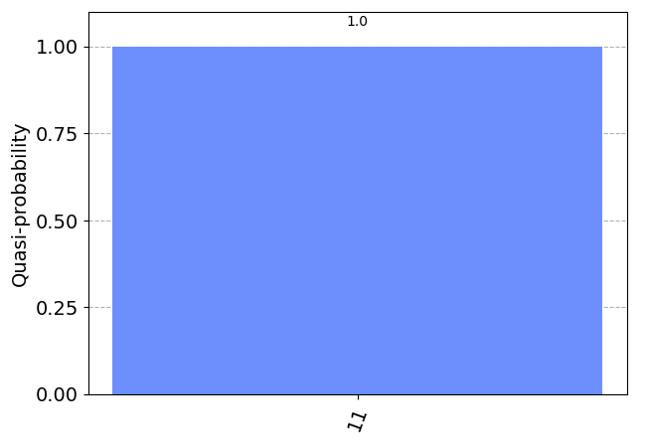
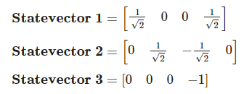
Check Cell 1 – superdense_coding.ipynb

Slide 10
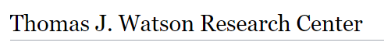
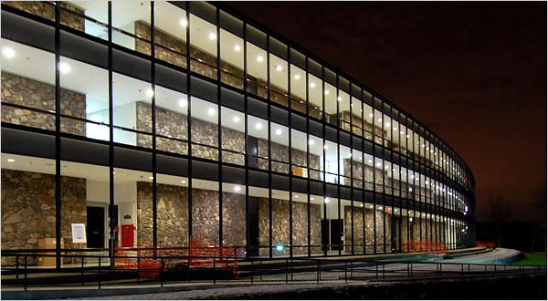
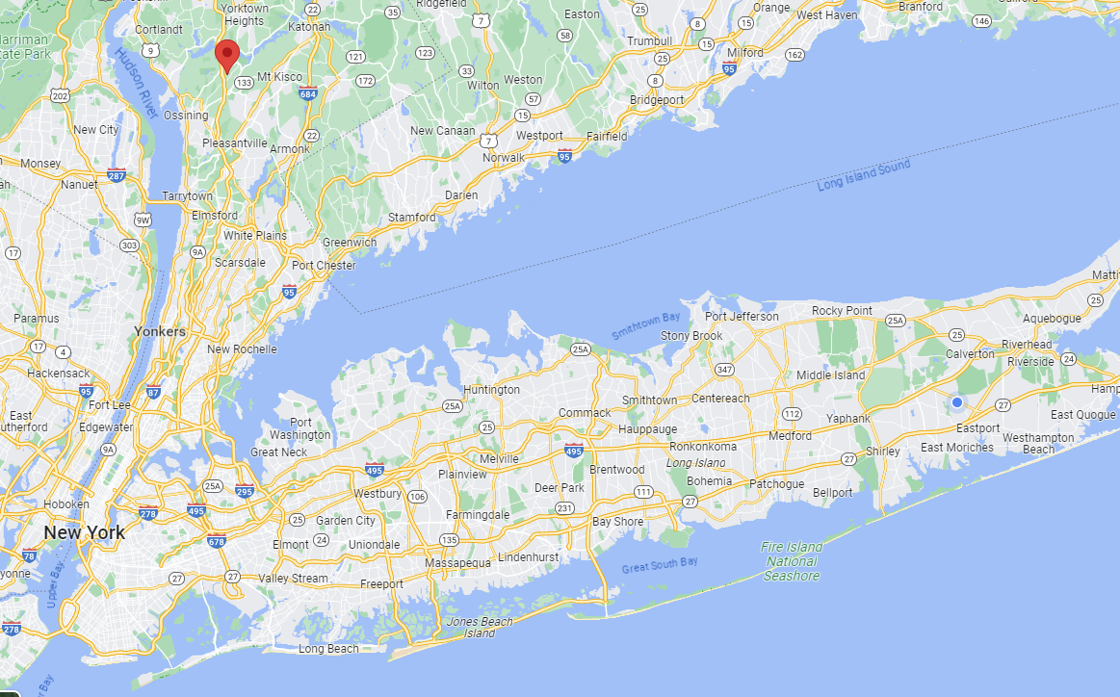
IBM Quantum Computers
Yorktown Heights, NY

Slide 11
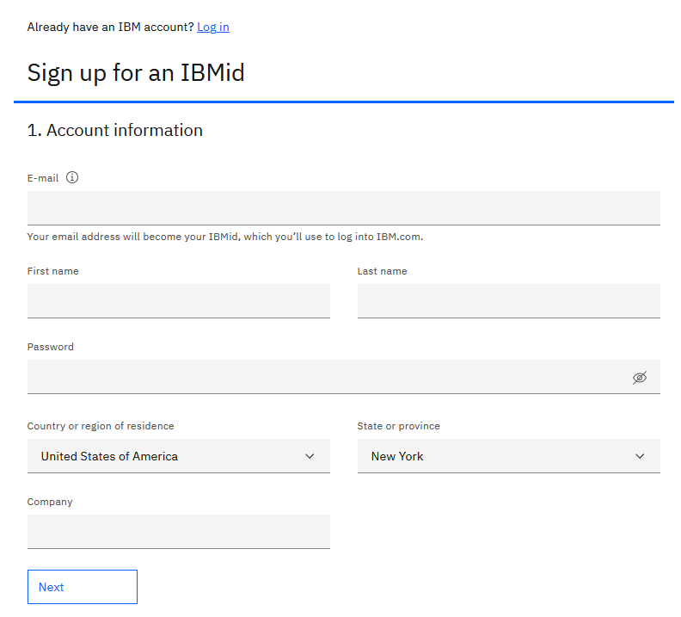
Create an IBM Account
https://www.ibm.com/account/reg/us-en/signup?formid=urx-19776

Slide 12
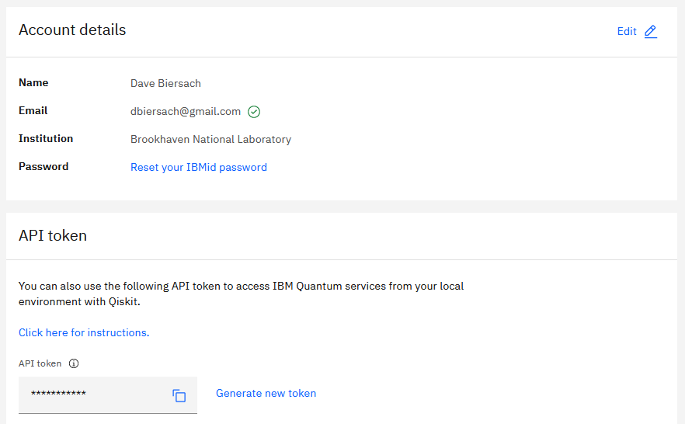
Create an API Token
https://quantum-computing.ibm.com/account

Slide 13
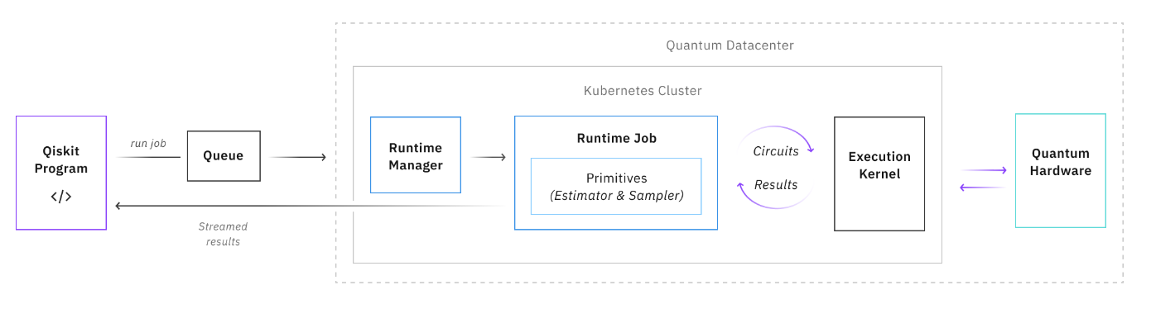
IBM Qiskit Runtime
https://quantum-computing.ibm.com/admin/docs/admin/runtime

Slide 14
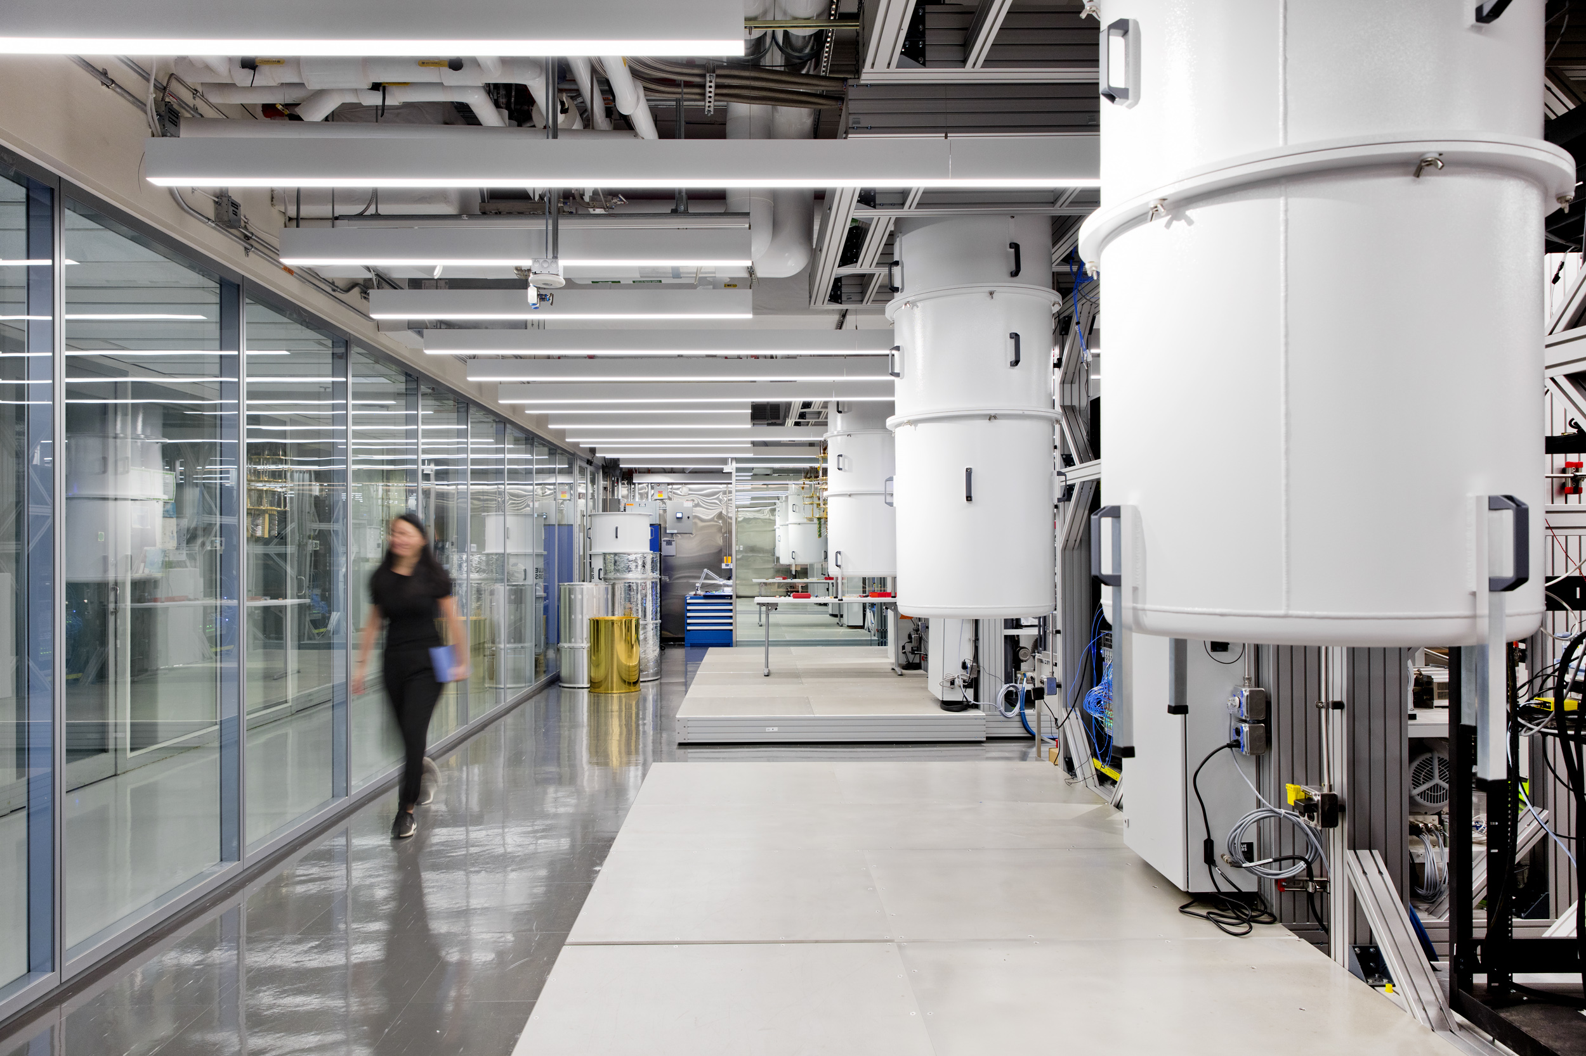
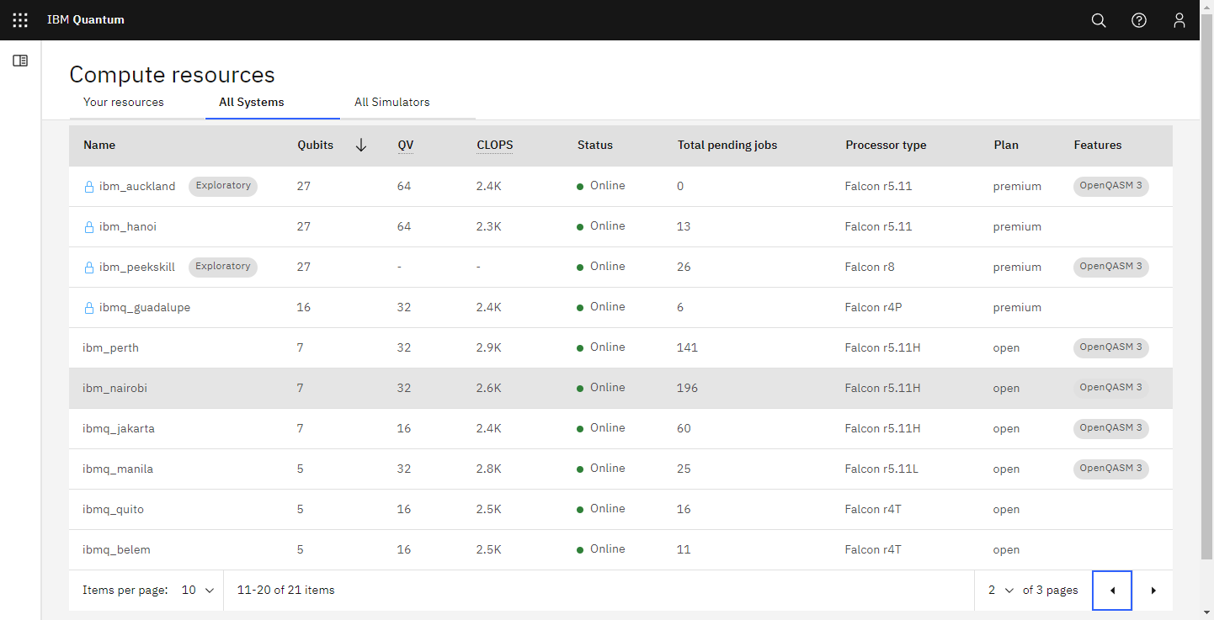
IBM Qiskit Runtime – Available Computers
https://quantum-computing.ibm.com/services/resources?tab=systems

Slide 15
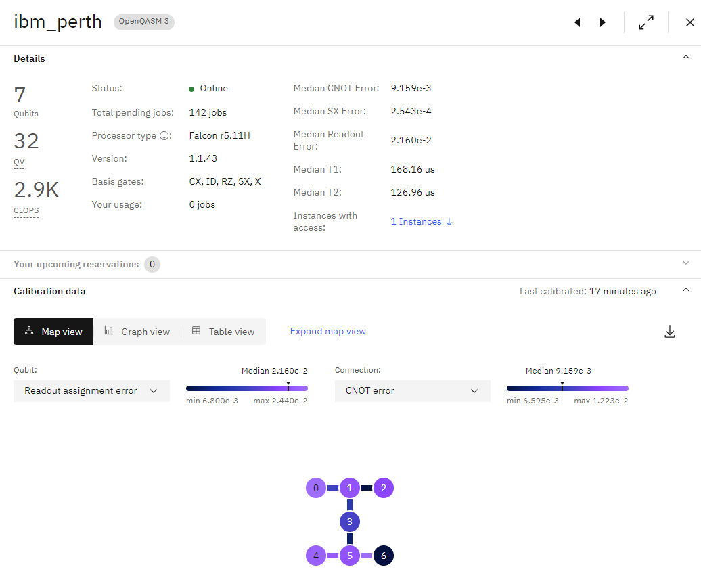
IBM Qiskit Runtime – Available Computers
https://quantum-computing.ibm.com/services/resources?tab=systems

Slide 16
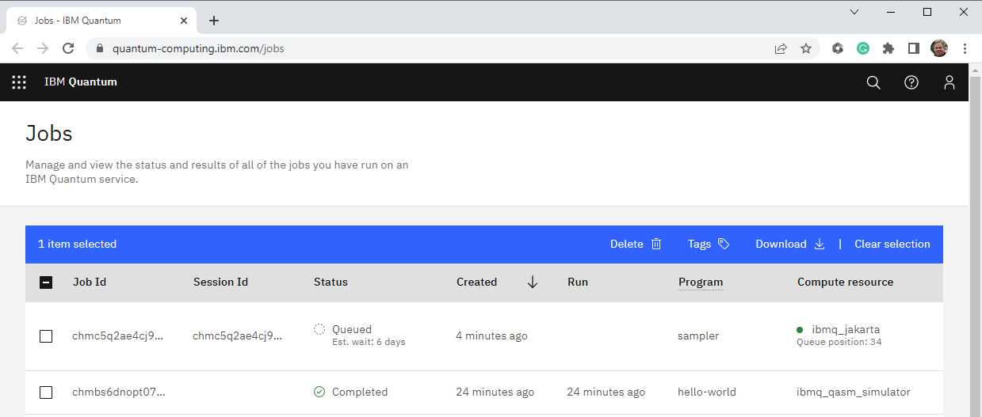
IBM Qiskit Runtime – Your Jobs
https://quantum-computing.ibm.com/jobs

Slide 17
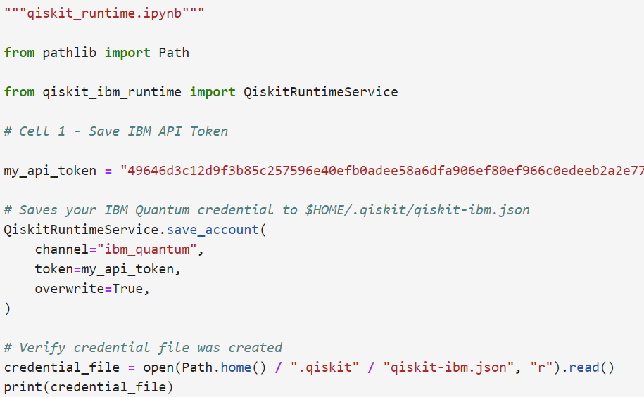
Edit Cell 1 – qiskit_runtime.ipynb
①
Paste your API key here
②

Slide 18
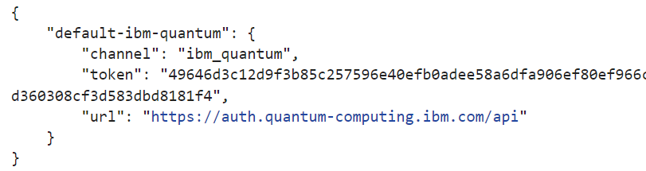
Run Cell 1 – qiskit_runtime.ipynb
$HOME/.qiskit/qiskit-ibm.json
①
Your API key

Slide 19
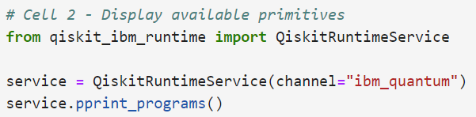
View Cell 2 – qiskit_runtime.ipynb
①
②
③

Slide 20
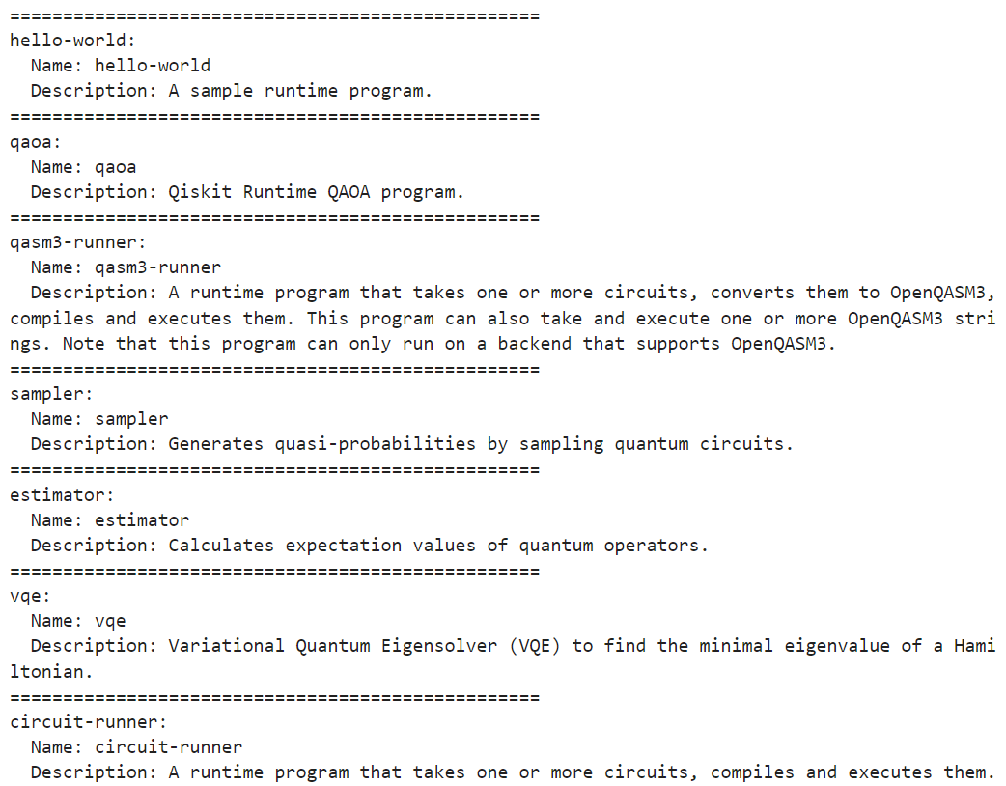
Run Cell 2 – qiskit_runtime.ipynb
①
②
③

Slide 21
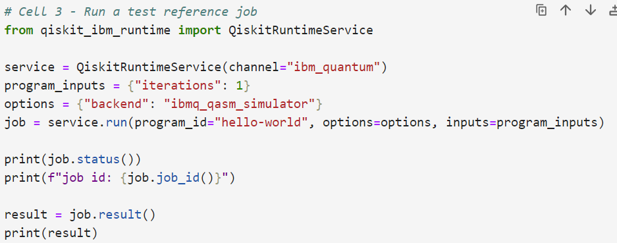
View Cell 3 – qiskit_runtime.ipynb
①
②
③
④
⑤

Slide 22
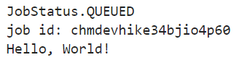
Run Cell 3 – qiskit_runtime.ipynb
①
②
③
④
⑤
⑥
⑦
⑧
Your notebook will WAIT here!
⑨
⑥
⑦
⑨

Slide 23
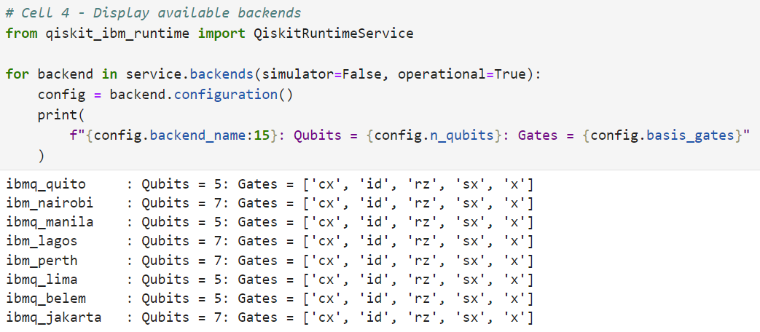
Run Cell 4 – qiskit_runtime.ipynb
①
②
③

Slide 24
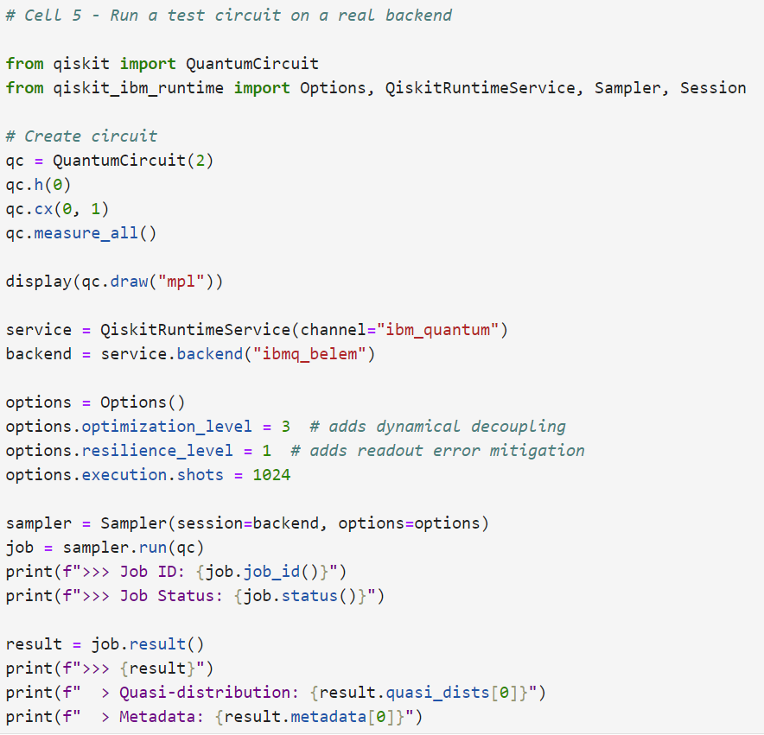
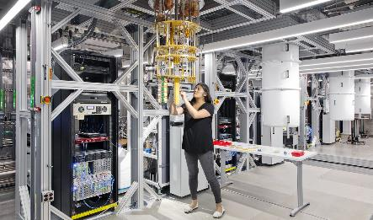
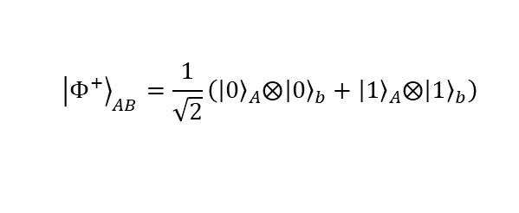
View Cell 5 – qiskit_runtime.ipynb
①
②
③
$${\left.\left|Φ^{+}\right.\right\rangle }_{AB}=\frac{1}{\sqrt{2}}\left({\left.\left|0\right.\right\rangle }_{A}⨂{\left.\left|0\right.\right\rangle }_{b}+{\left.\left|1\right.\right\rangle }_{A}⨂{\left.\left|1\right.\right\rangle }_{b}\right)$$
https://en.wikipedia.org/wiki/Bell_state
②
③
④
⑤
⑥

Slide 25
Run Cell 5 – qiskit_runtime.ipynb
$${\left.\left|Φ^{+}\right.\right\rangle }_{AB}=\frac{1}{\sqrt{2}}\left({\left.\left|0\right.\right\rangle }_{A}⨂{\left.\left|0\right.\right\rangle }_{b}+{\left.\left|1\right.\right\rangle }_{A}⨂{\left.\left|1\right.\right\rangle }_{b}\right)$$
https://en.wikipedia.org/wiki/Bell_state
⑦
Your notebook will WAIT here!
⑧

Slide 26
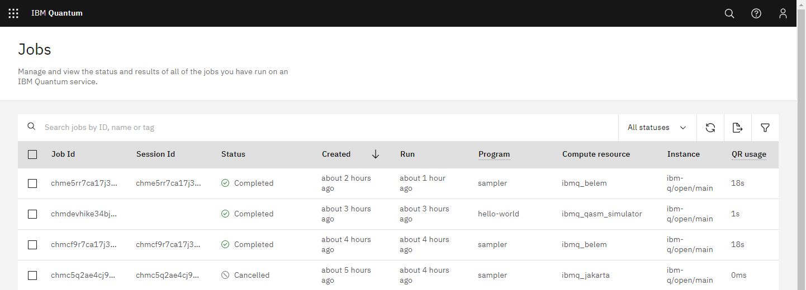

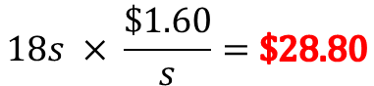
Run Cell 5 – qiskit_runtime.ipynb
Wait time before run: 1 hour
Time to run circuit: 18 seconds
https://www.ibm.com/quantum/access-plans
$$18s × \frac{\$1.60}{s}=\$28.80$$
For just one run of the simplest 2-qubit entanglement circuit possible with only 1,024 shots

Slide 27
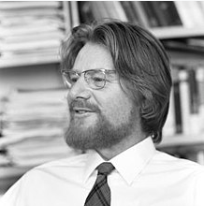
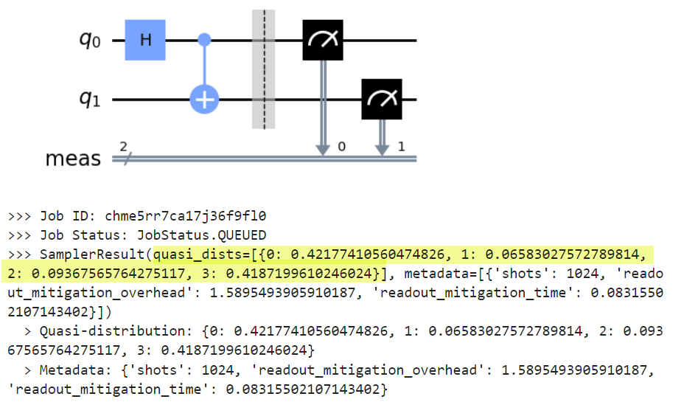
Run Cell 5 – qiskit_runtime.ipynb
①
John Stewart Bell
(1928 – 1990)
②

Slide 28
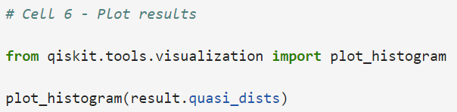
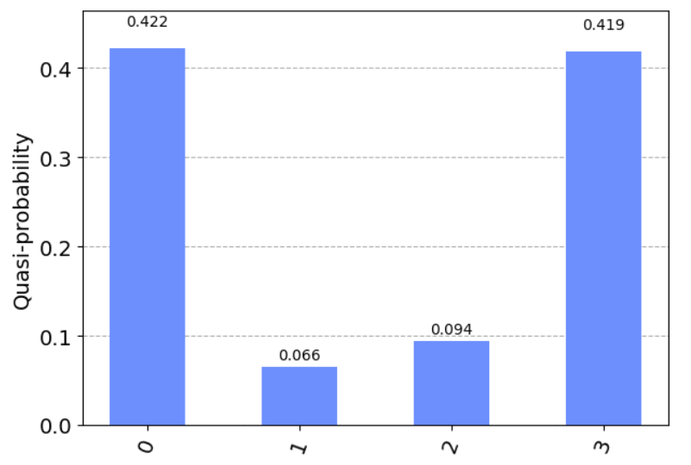
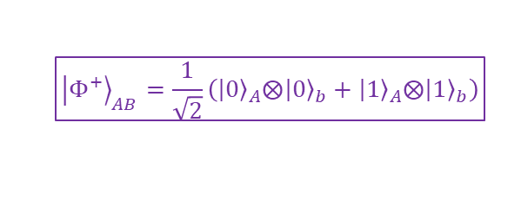
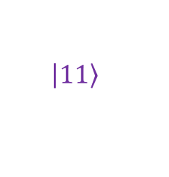

Run Cell 6 – qiskit_runtime.ipynb
①
②
$${\left.\left|Φ^{+}\right.\right\rangle }_{AB}=\frac{1}{\sqrt{2}}\left({\left.\left|0\right.\right\rangle }_{A}⨂{\left.\left|0\right.\right\rangle }_{b}+{\left.\left|1\right.\right\rangle }_{A}⨂{\left.\left|1\right.\right\rangle }_{b}\right)$$
https://en.wikipedia.org/wiki/Noisy_intermediate-scale_quantum_era
NISQ
Noise
$$\left.\left|00\right.\right\rangle$$
$$\left.\left|11\right.\right\rangle$$

Slide 29
Why Phase Estimation is Important
Eigenvalue problems: Many problems in physics and chemistry can be reduced to finding the eigenvalues of a unitary operator, which correspond to measurable quantities of a quantum system. For example, in quantum chemistry, a molecule's energy levels correspond to the Hamiltonian operator's eigenvalues
Quantum algorithms: QPE is a central part of several critical quantum algorithms, such as Shor's algorithm for factoring and the Quantum Phase Estimation version of Grover's search algorithm. It's also used in quantum simulation algorithms, where the goal is often to find the eigenvalues of a unitary operator
Quantum machine learning: Certain quantum machine learning algorithms also rely on phase estimation to accelerate learning
Quantum error correction: Phases also play a crucial role in quantum error correction and fault-tolerant quantum computing, where phase estimation techniques can detect and correct errors

Slide 30
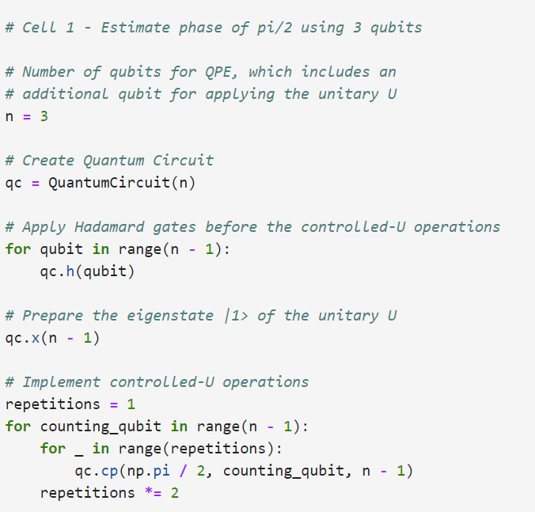
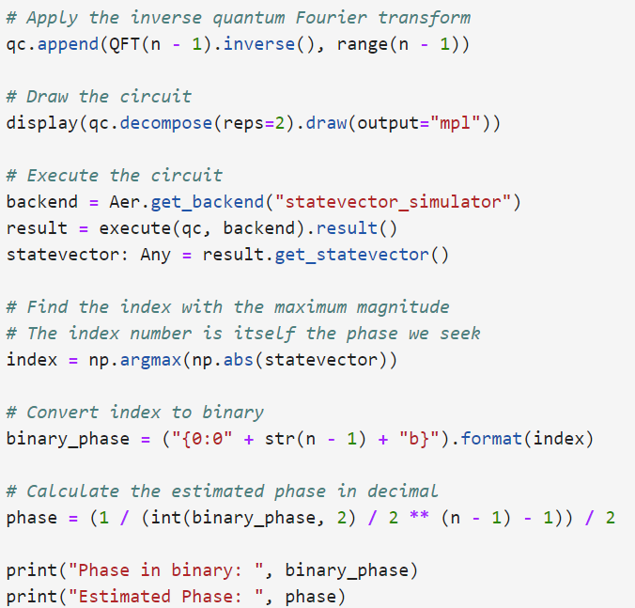
View Cell 1 – qpe.ipynb
⑦
①
⑧
②
③
⑨
④
⑤
⑥
⑩

Slide 31
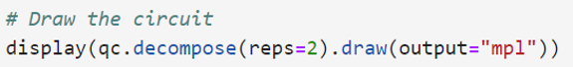






Run Cell 1 – qpe.ipynb
$$n=3$$
$${101}_{2}=5_{10}$$
$$\frac{5}{2^{n−1}}=\frac{5}{2^{3−1}}=\frac{5}{2^{2}}=\frac{5}{4}=1.25$$
$$\frac{1}{1.25−1}=\frac{1}{0.25}=4×\frac{1}{2}=2.0$$

Slide 32

View Cell 2 – qpe.ipynb
①
②
③

Slide 33





Run Cell 2 – qpe.ipynb
$$n=5$$
$${1001}_{2}=9_{10}$$
$$\frac{9}{2^{n−1}}=\frac{9}{2^{4−1}}=\frac{9}{2^{3}}=\frac{9}{8}=1.125$$
$$\frac{1}{1.125−1}=\frac{1}{0.125}=8×\frac{1}{2}=4.0$$

Slide 34

View Cell 3 – qpe.ipynb
①
②
③

Slide 35



Run Cell 3 – qpe.ipynb
With 16 qubits and 50+ quantum gates, we can no longer draw the circuit
The more qubits we use the more precise we can be in our phase estimation
$$n=16$$
$${1001110111011101}_{2}={40413}_{10}$$
$$\frac{40413}{2^{n−1}}=\frac{40413}{2^{16−1}}=\frac{40413}{2^{15}}=\frac{40413}{32768}=1.2333069$$
$$\frac{1}{1.2333069−1}=\frac{1}{0.2333069}=4.2179471×\frac{1}{2}=2.1431001$$

Slide 36






The Eigenvalue Problem
In quantum mechanics, a Hamiltonian operator represents a physical system's total energy, and being a Hermitian operator, it has all real eigenvalues. The eigenvectors of the Hamiltonian operator represent the possible states in which those specific energy values can be measured
Therefore, to determine the observable properties of a system described by a Hamiltonian, one must find the eigenvalues and eigenvectors of the Hamiltonian operator, aka its eigensystem
Potential Function
$$\hat{H}=−\frac{ℏ^{2}}{2m}\frac{d^{2}}{dx^{2}}+V\left(x\right)$$
$$\hat{H}\left[ψ\left(x\right)\right]=E\left[ψ\left(x\right)\right]$$
$\hat{H}$ acts on $Ψ$
$$\left\langle ψ | \hat{O} | ψ\right\rangle$$
$ψ\left(x\right)$ = Eigenfunctions of the Hamiltonian
The expected value of an observable
$E$= Eigenvalues of the Hamiltonian

Slide 37

The Eigenvalue Problem
A cosine potential typically appears in models of periodic systems, most notably in the Josephson junction and condensed matter systems. The potential energy function in these systems can be represented as $V\left(x\right)=A\cos\left(kx\right)$, where x is the position
In quantum mechanics, the energy eigenstates of a Hamiltonian are the solutions to the Schrödinger equation. Solving the Schrödinger equation for a system with a cosine potential is not straightforward and cannot usually be done analytically, except in some special cases or approximations
The lowest energy eigenstate, also known as the ground state, of a Hamiltonian based upon a cosine potential is a non-trivial problem to solve exactly. Numerical methods or approximation methods, like perturbation theory or variational methods, must be used

Slide 38
The Eigenvalue Problem
The Hartree–Fock method is typically used to solve the time-independent Schrödinger equation for a multi-electron atom. There are no known analytic solutions for many-electron systems, so the problem must be estimated numerically using a nonlinear method
As an example, the benzene molecule consists of 12 nuclei and 42 electrons. The Schrödinger equation, which must be solved to obtain the energy levels and wavefunction of this molecule, is a partial differential eigenvalue equation in the three-dimensional coordinates of the nuclei and electrons, giving 3 × 12 + 3 × 42 = 36 nuclear + 126 electronic = 162 variables for the wave function
The computational complexity, i.e., the computational power required to solve an eigenvalue equation, increases faster than the square of the number of coordinates

Slide 39

The Eigenvalue Problem
In the context of quantum computing, the Variational Quantum Eigensolver (VQE) algorithm can be used to estimate the ground state energy. This algorithm uses a parameterized quantum circuit to prepare a state $\left.\left|ψ\right.\right\rangle$ and a classical optimizer to adjust the parameters of this circuit minimize the expectation value of the energy $\left\langle ψ | \hat{H} | ψ\right\rangle$
We can represent the Hamiltonian, which is usually in the fermion basis, in the basis of qubits using the Jordan-Wigner (JW) transformation or the Bravyi-Kitaev (BK) transformation
Therefore, to find the solution to a complicated Schrödinger wave equation, we first convert the Hamiltonian to a quantum circuit, and then use VQE to find the eigensystem for that operator
The process of mapping a continuous-variable system (such as a cosine potential) to a discrete, qubit-based system is a topic of ongoing research in quantum computing

Slide 40

COBYLA Optimizer
Michael Powell
(1936 – 2015)
The Constrained Optimization BY Linear Approximations (COBYLA) algorithm is a numerical optimization method for constrained problems where the derivative of the objective function is not known
COBYLA constructs successive linear approximations of the objective function and the constraints via a simplex of n+1 points (in n dimensions)
In the context of Qiskit, the COBYLA optimizer is often used in variational quantum algorithms, where the objective function corresponds to the expectation value of a quantum operator with respect to a parametrized quantum state
In these cases, the objective function can be evaluated by running a quantum circuit on a quantum computer or simulator, but its derivative is not readily available, making COBYLA a suitable choice

Slide 41

View Cell 1 – vqe.ipynb
①
②
A two-qubit parameterized initial state vector
③
④
⑤
⑥
⑦
⑧
⑨
⑩

Slide 42


Run Cell 1 – vqe.ipynb

Slide 43



Simulating Molecules using VQE
https://learn.qiskit.org/course/ch-applications/simulating-molecules-using-vqe
Be wary of leaning on never-ending layers of "convenience" abstraction

Slide 44

Propositional Calculus
In 1972, Stephen Cook showed that the Boolean satisfiability problem (SAT) is NP-complete on classical computers – it takes exponential time to be always correct
SAT asks whether the variables of a given Boolean formula can be consistently replaced by the values TRUE or FALSE in such a way that the formula evaluates to TRUE
$\left(ab\right)\left(bc\right)\left(ac\right)=1$ ✓
$\left(ab\right)\left(bc\right)\left(a\overline{c}\right)=1$ ☹
In many SAT formulas, the only recourse is to brute-force enumerate (like a truth table) all possible input values to see if any permutation can produce the output
Not possible!

Slide 45



















SAT using Qubits
$\left(ab\right)\left(bc\right)\left(ac\right)=1$ ✓
$$q_{12}$$
$$q_{10}$$
$q_{11}$(=T)
What if a, b, and c start in superposition?
$$q_{8}$$
$$q_{9}$$
$$q_{5}$$
$$q_{6}$$
$$q_{7}$$
$$\left(ac\right)$$
$$\left(bc\right)$$
$$\left(ac\right)$$
CCX
$q_{0}$(=a)
$q_{1}$(=b)
$$q_{4}$$
AND
$q_{2}$(=c)
$q_{3}$(=T)

Slide 46




View Cell 1 – satisfiability.ipynb
①
②
③
④
⑤
⑥
⑦
⑧
⑨
⑩

Slide 47



Run Cell 1 – satisfiability.ipynb
At least some shots showed the Boolean formula is satisfiable!

Slide 48


What about an impossible SAT?
$\left(ab\right)\left(bc\right)\left(a\overline{c}\right)=1$ ☹
$$q_{12}$$
We are inverting the c qubit in this term only!
$$q_{10}$$
$q_{11}$(=T)
$$q_{8}$$
$$q_{9}$$
$$q_{5}$$
$$q_{6}$$
$$q_{7}$$
$$\left(ac\right)$$
$$\left(bc\right)$$
$$\left(ac\right)$$
$q_{0}$(=a)
$q_{1}$(=b)
$$q_{4}$$
$q_{2}$(=c)
$q_{3}$(=F)

Slide 49


View Cell 2 – satisfiability.ipynb
①
In Qiskit qubits are initialized to |0>
④
⑤
④
⑥

Slide 50


Run Cell 2 – satisfiability.ipynb
No shots could make the Boolean formula satisfiable!

Slide 51
Why Quantum Programming Is Hard
Programmers must think in terms of operators (unitary matrices) and reversibility (ancilla bits, uncomputation)
Entanglement is hard to track mentally and even harder to visualize - but therein lies the true power of quantum computing
Physical device limitations (# qubits, # shots, noise)
If you cannot first understand the algorithm mathematically, it will be difficult to implement it correctly on a quantum computer
Phase kickback, amplitude amplification, and the Quantum Fourier Transform (QFT) are the current building blocks of most quantum algorithms – learn these techniques!

Slide 52
Session 24b – Now You Know
Superdense coding allows us to transmit two classical bits in just one qubit, effectively doubling information density – but requires the physical splitting of an entangled Bell pair
You need a personal IBMid to access IBM's quantum hardware and IBM's cloud services – be sure to enable MFA!
The QiskitRunTimeService is the coordinator between your local Python script and the execution of that circuit on remote IBM hardware quantum devices
The Qiskit Sampler primitive is used for obtaining measurements from a quantum circuit
The Qiskit Estimator primitive calculates expectation values from input circuits and observables

Slide 53
Session 24b – Now You Know
The main goal of Quantum Phase Estimation (QPE) is to find a good approximation for the eigenvalue associated with a given eigenvector. It does this by applying a series of controlled unitary operations and inverse the Quantum Fourier Transforms (QFT)
The Variational Quantum Eigensolver (VQE) is a hybrid classical-quantum algorithm that's often used in quantum chemistry, where determining the ground state energy of a molecule can give insights into its properties and behavior
Our approach to solving the Boolean Satisfiability Problem in polynomial time using a quantum circuit reveals that superposition does not mean a qubit has simultaneously assumed every possible value at every possible instant

Slide 54
What about QIS201?
Mixed States
Density Matrices
State Fidelity
Trotterization
Noise Models
OpenQASM
Qiskit Transpiler
Qiskit Pulses & Calibration
Quantum Error Correction
Quantum Fourier Transform (QFT)
Quantum Approximate Optimization Algorithm (QAOA)
Quantum Tomography
Quantum Machine Learning

Slide 55


